Slide 1

Python Workshop
Session 4

Slide 2
Covering Today
Lists and Collections Advanced
Function cheat sheet
Recursion

Slide 3
Lists and Collection Advanced
Concept – Power tools for manipulating lists/collections in Python
Why?
Without most of these function doing these tasks everytime you wanted them to be done would be tedious and repetitive
These functions allow for essential access and modification of lists

Slide 4
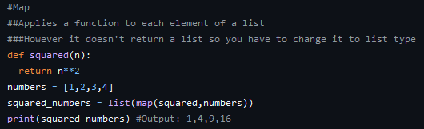
Lists and Collections Adv – Example 1

Slide 5
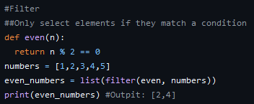
Lists and Collections Adv – Example 2

Slide 6
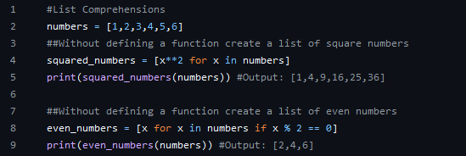
Lists and Collections Adv – Example 3

Slide 7
Lists and Collections - Dictionary
Def – Unordered collection of key-value pairs
Keys – Unique and immutable (string, numbers, tuples)
Values - Any data type
Accessing values
Value = dictionary[key]
Value = dictionary.get(key)
Modifying values
Dictionary[key] = value

Slide 8
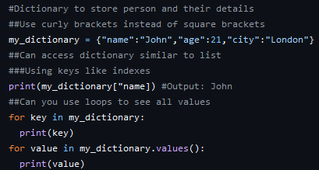
Lists and Collections – Dictionary Example

Slide 9
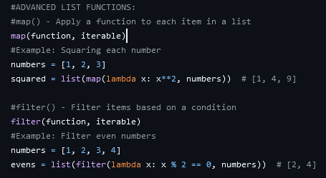
Functions Cheat Sheet

Slide 10
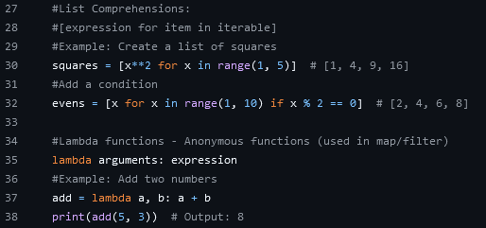
Functions Cheat Sheet

Slide 11
Recursion
Def – A function calling itself till a condition is met
Base case (what stops it) – The condition where is met which stops the recursion
Recursive case – Where the function calls itself with a smaller problem
Fibonacci
https://recursion.vercel.app/

Slide 12
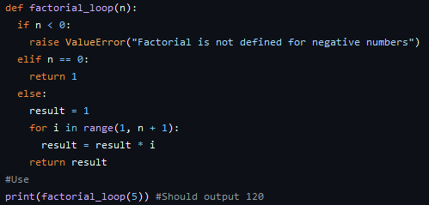
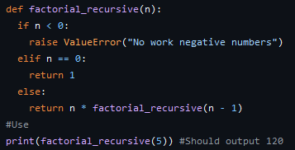
Recursion example against loops
For Loop
Recursion

Slide 13
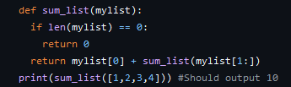
Recursion - Example

Slide 14
Recursion – Challenge
You are given a string, reverse the string and then return it to the user
You are not allowed to use any loops to iterate through the string

Slide 15
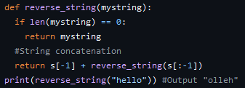
Recursion – Challenge Solution

